Slide 1
Preparer Resources and Tools
TaxPrep4Free.org Preparer Page

Slide 2
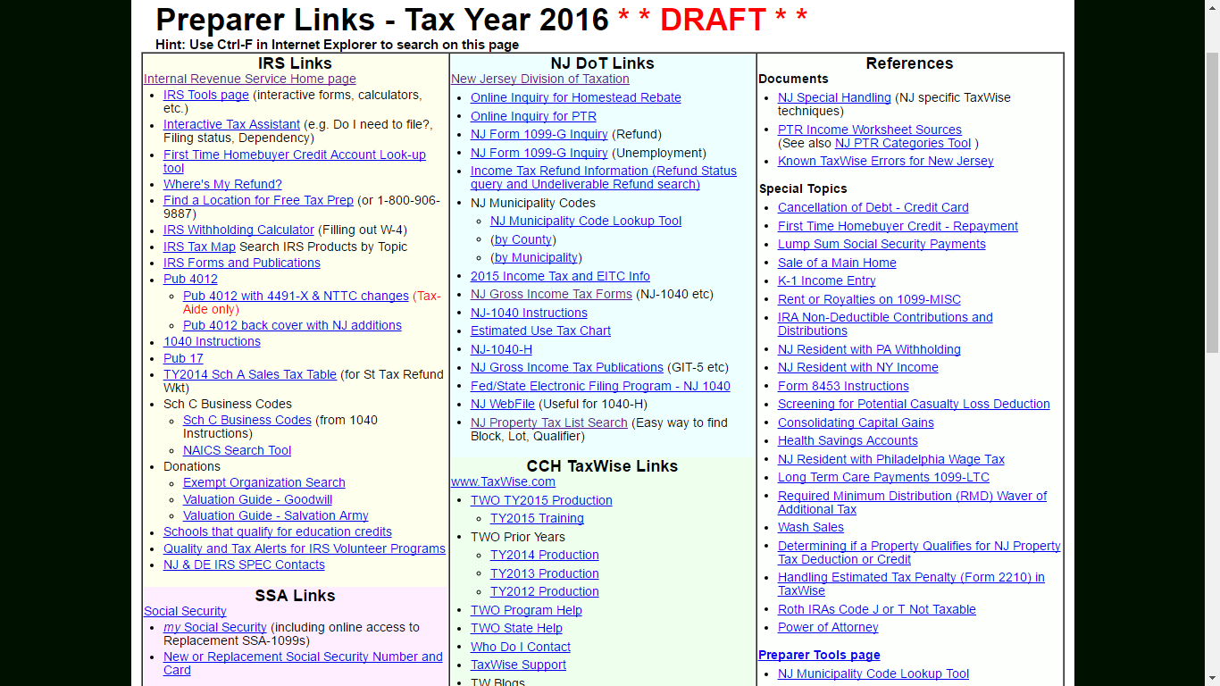
TaxPrep4Free.org Preparer Page

